Slide 1
COMMERCE –III ( MF)
Dr. Sumita Shankar

Slide 2
Competencies for 21st Century Managers

Slide 4
Human Skills

Slide 5
Technical skills

Slide 6
Communication Skills

Slide 7
Analytical Skills

Slide 8
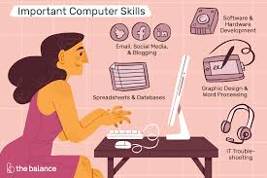
Computer skills

Slide 9
Problem Solving

Slide 10
ABILITY TO MOTIVATE

